Slide 1

Essential Spreadsheet Data Cleaning with OpenRefine
Sara Gonzales, MLIS
Data Librarian
Galter Health Sciences Library & Learning Center
Northwestern University Feinberg School of Medicine

Slide 2
What is OpenRefine?
An open source tool first developed by Google (originally called GoogleRefine)
A data-cleaning machine that requires no coding knowledge
(although it helps to learn a few ‘expressions’ – more on this later!)
A secure tool that runs in your local browser window, but does not share your data online

Slide 3

OpenRefine classes at GHSL: Introduction vs. Essentials
Introductory OpenRefine
-Splitting and joining rows
-Faceting and filtering (simple, text-based)
-Clustering
-Writing transformations
-GREL number and math functions
-Transforming Booleans
-Transforming Arrays
-Fetching data from URLs
-Reconciling data against online sources
Essential OpenRefine
-Additional facet types: Timeline, Scatterplot, and Numeric
-Transforming numeric value inconsistencies
-Duplicates facet
-Remove duplicates (blank down)
-Sort and facet by multiple columns
-Join two OpenRefine projects
-Installing extensions
-Reconciling data against the Medical Subject Headings
-Transpose columns into rows
Introductory OpenRefine topics adapted from Library Carpentries OpenRefine: https://librarycarpentry.org/lc-open-refine/

Slide 4
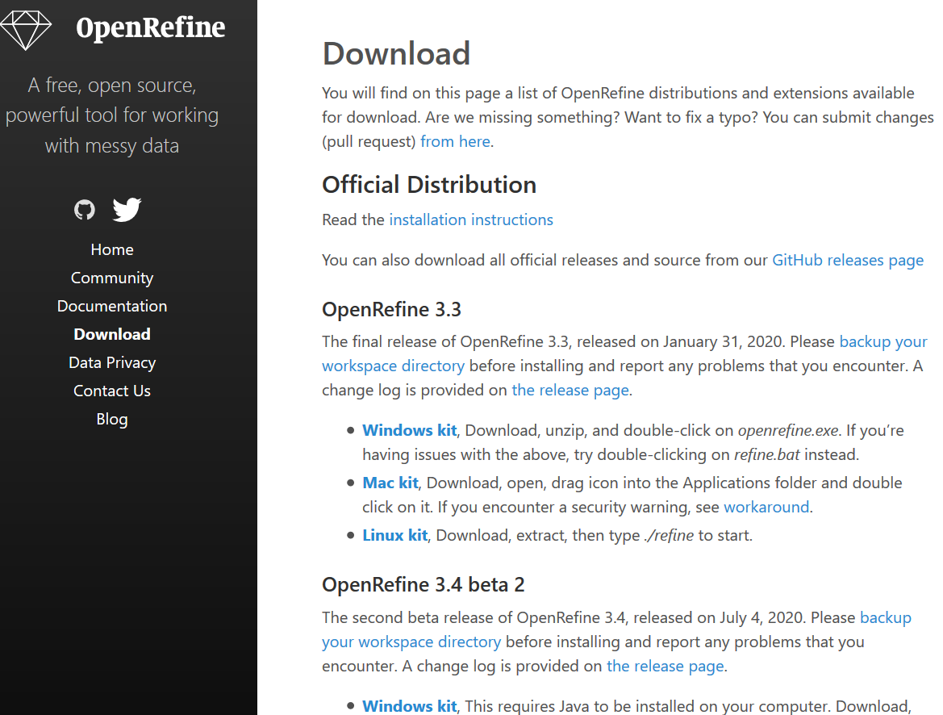
Download
Download OpenRefine from: http://openrefine.org/
Download the datasets for this class:
https://drive.google.com/file/d/1yoCmjy-EFroMV7M5UL9RwDYYTKAfYHbS/view?usp=sharing
“2019_NEISS_SmallSubset.csv”
AND:
https://drive.google.com/file/d/1IGBps15J-_9do2EULZKJGYRCpWZodzc-/view?usp=sharing
“NEISS_ProductCodes_ProductNames”
Notes:
-It’s best to download the latest, non-beta version. This is the version that is most likely to support any add-on features you might like to use, like reconciliation services
-Once downloaded, extract the files from the Zip folder, then open the .exe (executable file) and run it

Slide 5
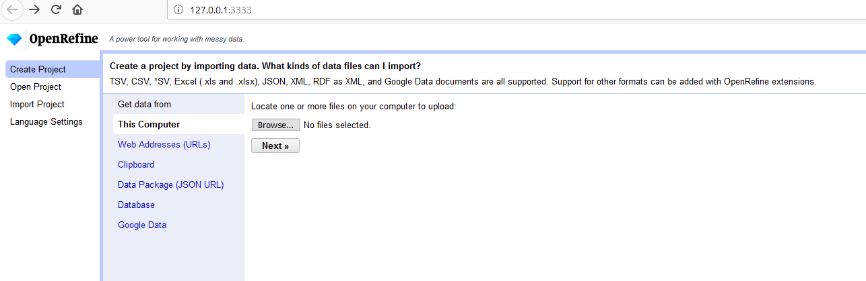
Open a Project
-Open CSV, Excel, JSON, and XML files stored on your computer
OR
-Fetch data from a Web Address

Slide 6
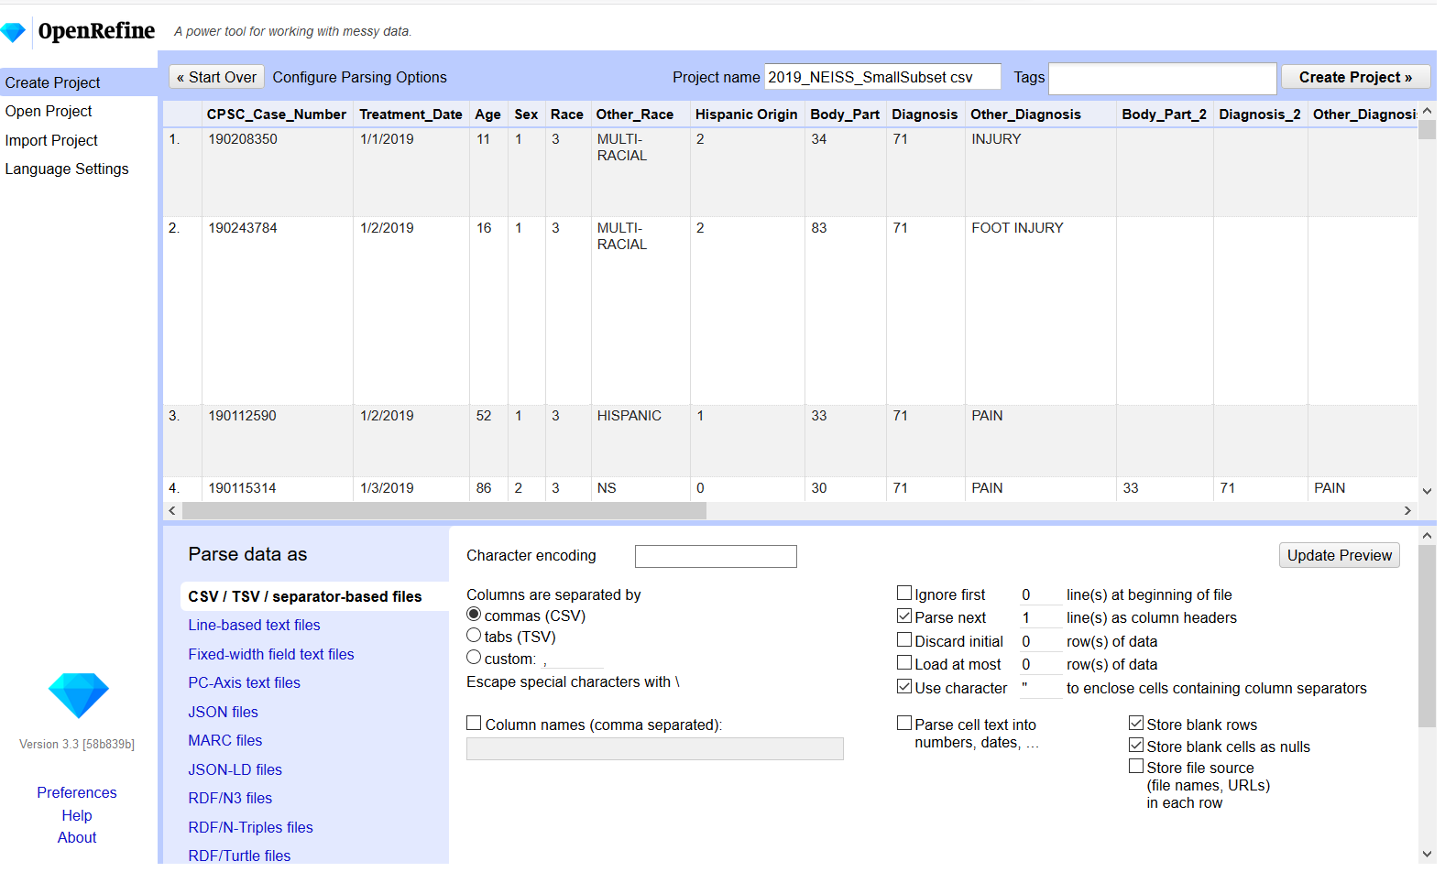


Uncheck this box
Notes:
You will see a preview of the first few rows of data immediately upon upload. At the bottom of the screen you’ll have some choices to make which will affect how your data will display. In “Character encoding,” click in the box and choose UTF-8. Check the box to parse the text of the first line of your data as column headers. For the purposes of this class, make sure that “Parse cell text into numbers, dates, etc.” is unchecked so OpenRefine won’t automatically try to identify numbers and dates. When the “Configure Parsing Options” screen looks like this, click “Create Project” in the upper right corner.
When working on your own, you can configure the parsing options any way you’d like. Experiment with changing the settings on a dummy dataset like this before trying the changes on a real project.

Slide 7
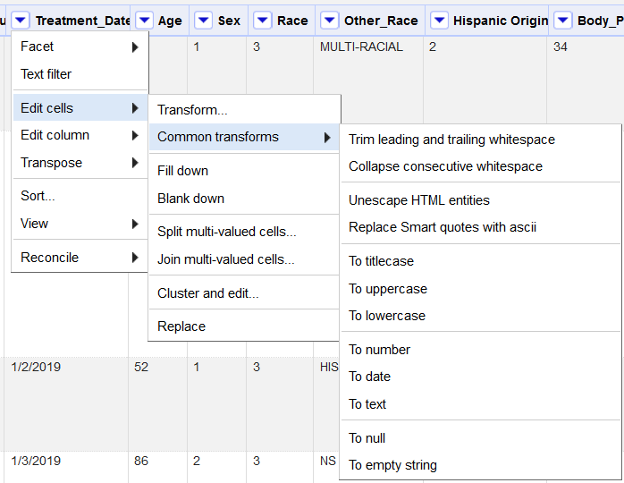
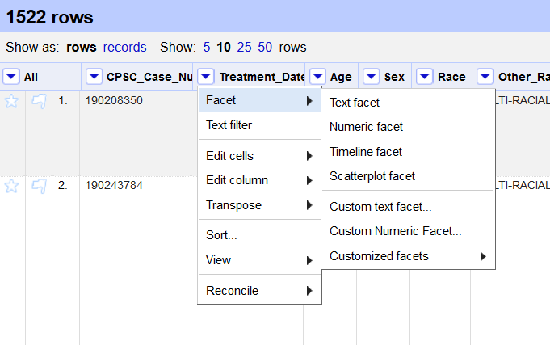


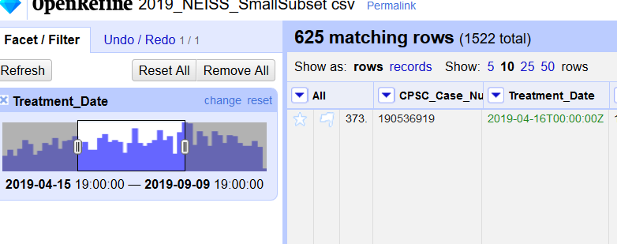
Beyond Text Facets: Timeline Facet
Notes:
Though the text facet is one of the most commonly used facets in OpenRefine (Text facet counts unique values and displays them, allowing quick and easy correction of data-entry errors), other commonly used ones are Timeline, Scatterplot, and Numeric facets.
We’ll use the Timeline facet on the Treatment Date Column. First the dates, which have been imported into the project in text format, must be changed to date format. From the Treatment Date column’s drop down arrow, choose Edit Cells – Common transforms – To date. The dates will then convert to an ISO standard date time format, in which times have been appended with all zeroes, as times were not available in the original data. Although this looks messy, it will allow the Timeline facet to work.
From the column’s drop down, choose Facet – Timeline facet and review the resulting chart. The dates are listed from the beginning to the end of 2019, with the bars representing the frequency of treatments on each date. Use the sliders on either end of the chart to hone in on a range of dates, or even a single date. Notice that the number of rows you’re viewing based on the range of dates you choose adjusts in real time.

Slide 8
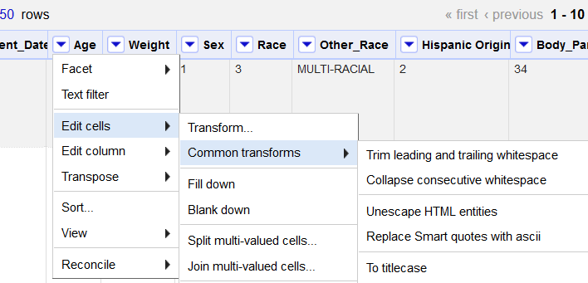

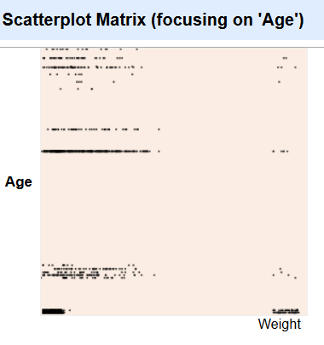

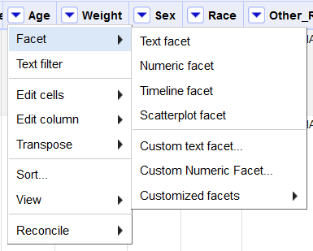

Beyond Text Facets: Scatterplot Facet
Notes:
The scatterplot facet is a quick and easy way to get a visual representation of how the values in two numeric columns relate to each other. We can try this facet on the Age and Weight columns of the NEISS dataset. First, from the “All” drop down arrow in the far left, choose “Edit Columns – Reorder/Remove Columns.” Weight appears at the bottom of this list; drag it close to the top, so it appears just after age. Then from the drop down arrows on both the age and weight columns, choose “Edit cells – Common transforms – To number.”
From the Age column drop down arrow, choose “Facet – Scatterplot facet.” OpenRefine will automatically generate the scatterplot graph using the number-based column to the right of the column we selected, which is Weight.

Slide 9
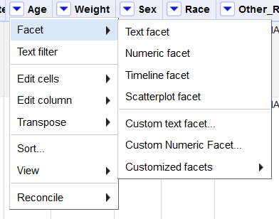
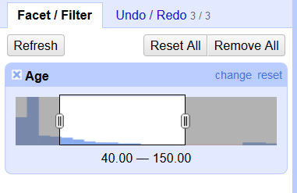
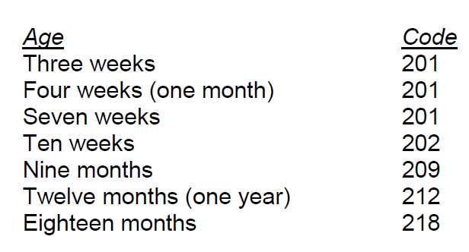
Beyond Text Facets: Numeric Facet
Notes:
Let’s look at a third type of facet, the Numeric facet, as applied to the Age column. From the Age column drop down arrow choose “Facet – Numeric facet.”
Much like the Timeline facet, this will result in a graph with sliders in the Facet/Filter area on the left of the screen. Use the sliders to narrow in on a subset of the dataset’s ages. However, there’s something strange in this example – the patients’ ages go up to 230! This happened because in the NEISS coding manual, coders were instructed to put a 2 in the first space of the age code whenever a patient’s age was expressed in months. (Ages from 0 – 4 weeks were grouped in the 1-month-old category). Let’s transform those values. First, use the sliders to select only the ages from 200 upward.

Slide 10
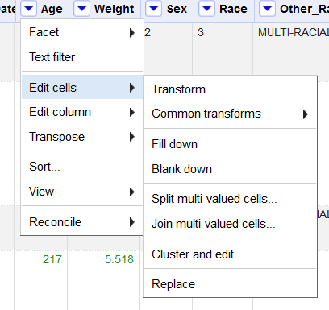

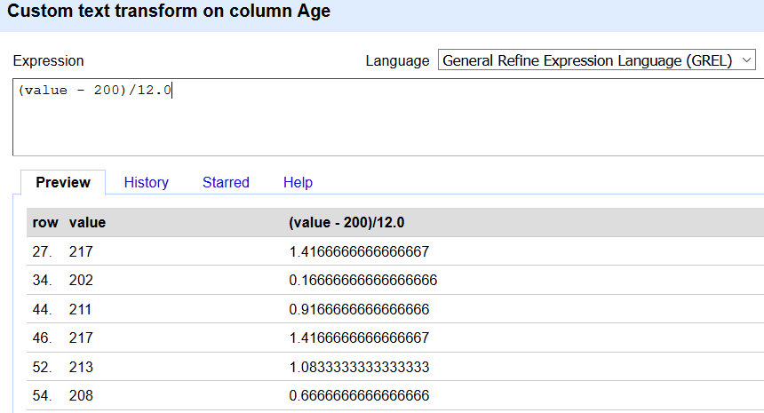

Transforming coded numbers with math functions
From the Age drop down, choose “Edit Cells → Transform”
Write a simple formula to transform the ages. GREL supports +, -, /, and *
Subtract 200 from each value to remove the unneeded “2” and isolate age in months. Divide by 12.0 (the .0 ensures a result in decimal format)
Notes:
A common necessary correction in biomedical datasets is correction of coding-based data errors. As we saw in the previous slide, NEISS coders were instructed to record the ages of patients with age expressed in months with a “2” at the beginning, making it appear at first glance that the patient is over 200 years. While intended to keep ages in years separate for processing purposes from ages in months, this will require correction either in the statistical analysis or other programs with which researchers will crunch this data, or here in OpenRefine before the dataset reaches that stage. The correction needed is a simple mathematical correction that can be done by subtracting 200, and dividing the resulting months by 12.0 to see the months expressed as a fraction of a year. The “’0” after the 12 is necessary when working in GREL – it tells OpenRefine to express the result as a decimal.

Slide 11

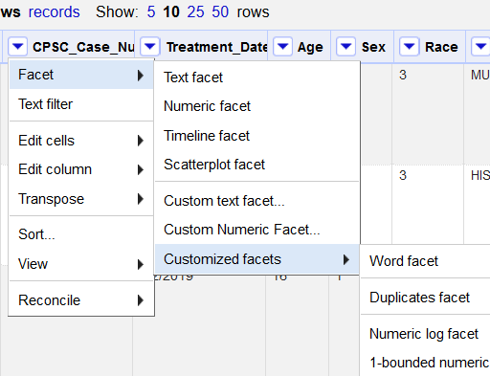
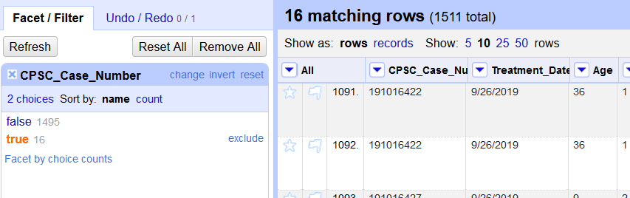
Beyond Text Facets: Duplicates Facet
Select “true” after applying the Duplicates facet to work only with the rows that have a duplicate
Notes:
The duplicates facet is another handy facet in OpenRefine. Use this facet on a column that should contain totally unique values for every instance in order to find duplicate row entries. Let’s try it on the CPSC_Case_Number column, since each NEISS incident should have its own case number. From the CPSC_Case_Number drop down arrow, choose “Facet – Customized facets – Duplicates facet.” The results will be a listing of true or false instances of duplicates for this field (referred to as a Boolean). Let’s choose the true instances, and check that they represent duplicate records. Then from the CPSC_Case_Number drop down arrow, choose “Sort – Sort Cell values as text,” since we have not changed them to numeric. The sort will group together all the rows that have the same CPSC_Case_Number.

Slide 12
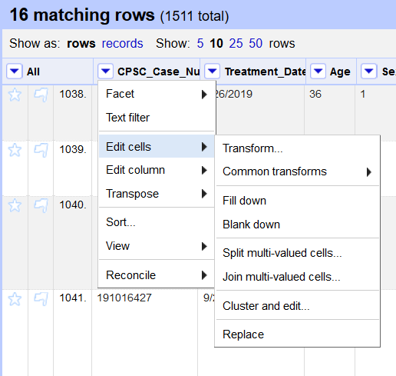
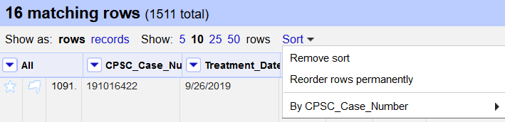
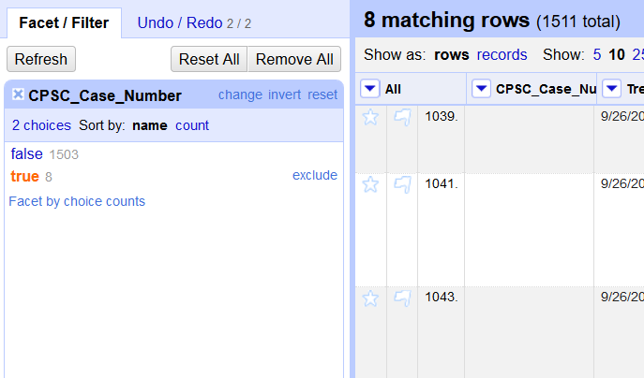
Remove duplicates – Blank down
Notes:
Apply the same Sort again as in the last step, using the CPSC_Case_Number column and sorting on text. A new Sort option should appear near your top navigation. From that drop down, choose “Reorder rows permanently.” This will help in our next step, when we work to blank down all the rows that are duplicates.
Next, from the CPSC_Case_Number column drop-down choose “Edit cells – Blank down.” A couple of things happened quickly here – OpenRefine automatically sought the duplicate CPSC_Case_Number values and made them blank. We still have a Duplicates facet working in the CPSC_Case_Number column, which is why we still have 8 rows that match for duplicates in this field. Only now, these rows have duplicate values for CPSC_Case_Number because that duplicate value is “blank.” Take the Duplicates filter off by x-ing out.

Slide 13
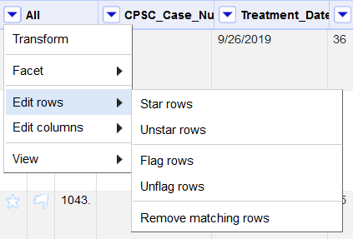
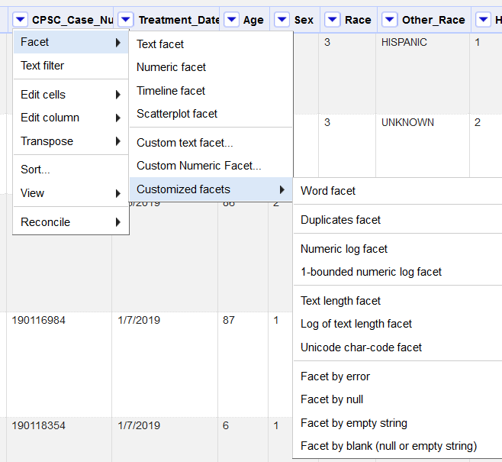
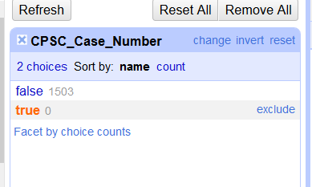
Facet by Blank and Delete rows
Notes:
After blanking down the duplicate CPSC_Case_Number values, even if we take off the Duplicates facet, we know that within this table, the corresponding 8 records still have blank values for CPSC_Case_Number. To delete the rows that have these blank values, we can choose from the CPSC_Case_Number column drop-down: “Facet – Customized facets – Facet by blank (null or empty string). In the resulting facet window on the left, you’ll see that there are 8 records that are “true” for having a blank value in the column CPSC_Case_Number. Choose “true” in this facet to isolate the 8 rows.
Next, from the “All” column drop-down towards the left, choose “Edit rows – Remove matching rows.” With the Facet by Blank still in place, you can see that OpenRefine just updated to show that now there are 0 rows that meet the criteria for being blank in the field CPSC_Case_Number. These rows have been removed, and our total number of rows has changed from 1511 to 1503.

Slide 14
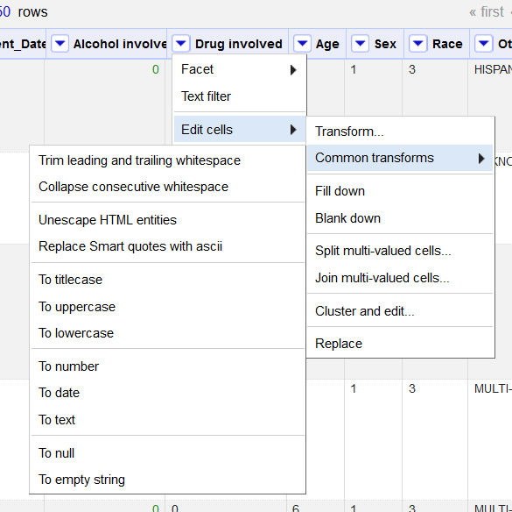
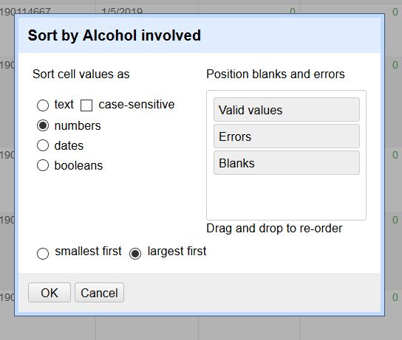
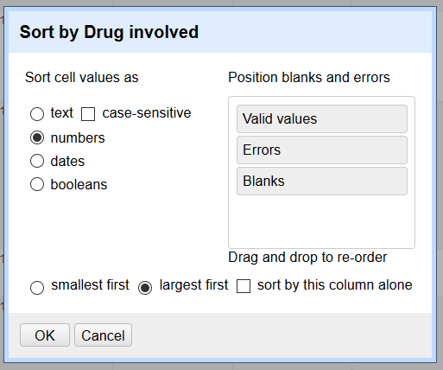
Sort on Multiple Columns
Notes:
At times you may want to employ sorts to explore your data in OpenRefine, or to learn more when numeric or other facets don’t give you much information. Let’s explore the quirks of sorts using the columns “Alcohol involved” and “Drug involved,” which denote whether alcohol or drug use was involved in the patient’s injury. From the All drop-down arrow, choose Edit Columns – Reorder/Remove columns to drag the “Alcohol involved” and “Drug involved” columns up, or, to the left.
Try a numeric facet on “Alcohol involved” What does it show? It seems that from the dataset of over 1500 records, only 10 are coded 1 for alcohol involvement. Drag the number slider to the right, and any designation over zero will be counted as the “1” value. X out of the numeric facet, and let’s try a sort. In the “Alcohol involved” column’s drop-down, choose Sort. In the dialog box which pops up, you can specify the type of data in the column, which in this case is numbers. You’ll then have the option to sort from smallest first or largest first .In this case, choose largest first. The ten records that have a “1” for alcohol involvement will be at the top. Expand the number of records visible on your screen to 25, and notice that it is still only the top ten that have a “1” value. Try the same sort on the “Drug involvement” column.
Notice that now by your smallest first or largest first options, a new checkbox has appeared called “sort by this column alone.” If you choose this option, it will restart the sort using this column. You can employ this option, but if so you will lose the previous sort. Let’s choose largest first for now. This sort shows us that only one record in this dataset shows positive for both alcohol and drug involvement.
The “Sort by” dialog box also give you many options for how to handle the various types of values that might be present in the columns. You can choose in which order you would like to see valid values, errors, and blank cells. Remember that having a handle on blank cells can be handy for finding all matching blanks and deleting them.

Slide 15
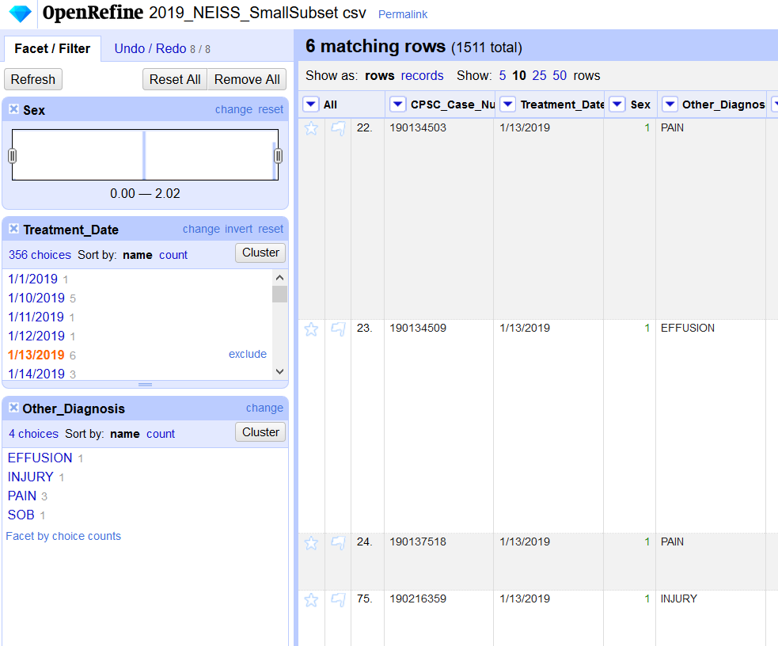
Facet on Multiple Columns
For most data cleaning tasks, faceting on one column at a time works well in order to isolate discrete fields of data
Multiple facets can be enabled at once, on both text and numeric fields
By “including” or narrowing in on certain entries within a facet, the other facets will update (narrow down) based on the first entry you selected. This essentially takes a slice of your data, one variable at a time

Slide 16
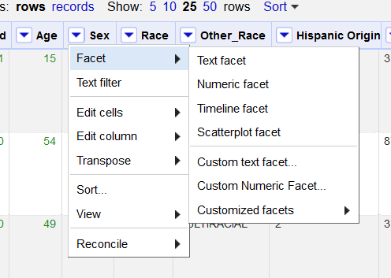
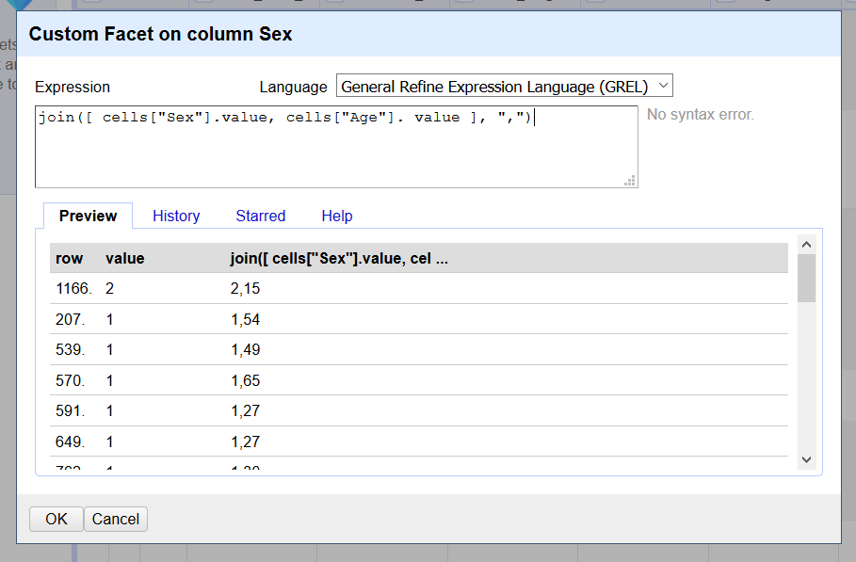
Facet on more than one column – a shortcut
Notes:
If you’ve taken Galter’s introductory OpenRefine class or have used the program a bit yourself, you’re probably familiar with the power of facets for cleaning data. While much data cleaning can be done by faceting on one column at a time, it’s also possible to facet on two columns or more at once. You can apply these multiple facets manually to hone in on highly specified subsets of your data. You can even combine text-based and numeric facets at the same time.
A quick way to facet on two columns at once is to choose “Custom text facet” from any column’s facet menu and enter the formula: join([ cells[“Col 1"].value, cells[“Col 2"]. value ], ",") in the Expression box. Substitute the columns you want to facet together in the Col 1 and Col 2 spaces. Inside the last quote marks after value, use any separator you would like to keep the two columns’ values visually separated As you can see from the result, this custom facet allows us to hone in on male or female patients of particular ages.

Slide 17
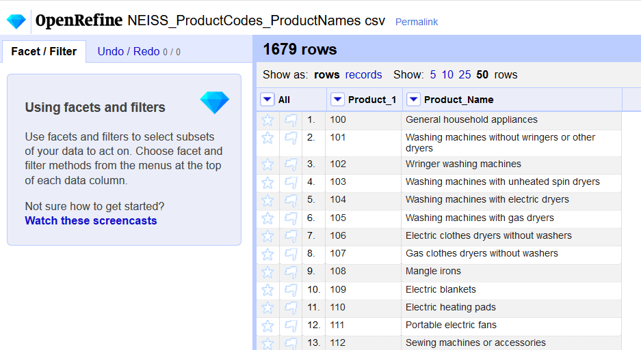
Join Data from Two OpenRefine Projects
From your main project screen, select “Open,” a button on the far right. This brings you back to the Open or Create Project screen. Browse to the CSV file “NEISS_ProductCodes_ProductNames.csv “ that you downloaded earlier and open it as a new project.
The ProductCodes_ProductNames CSV has the key column (the one that contains the same unique values in both projects, “Product_1”), and the column that we want to bring over to our original project, “Product_Name.”
Notes:
In many data projects you may find that you need to combine data from two tables or spreadsheets. In our case, we have NEISS product numbers referenced in our original dataset, but we don’t know what products these numbers refer to. We need to bring over the names of the products from another table. This table is the other CSV file mentioned at the top of the class, entitled: “NEISS_ProductCodes_ProductNames.csv”

Slide 18
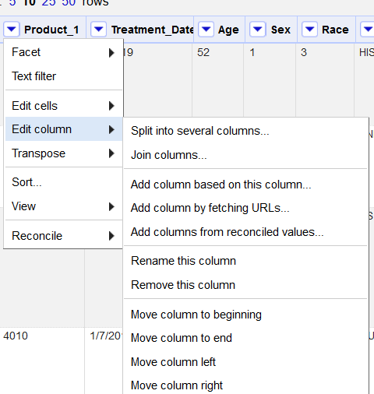
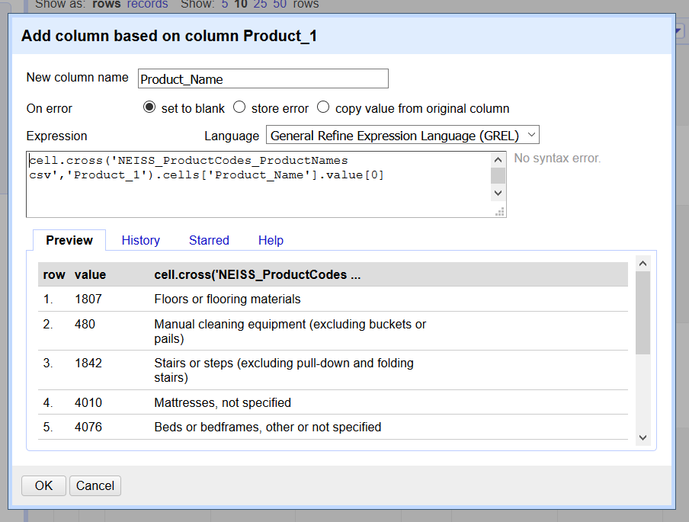
Join Data from Two OpenRefine Projects
cell.cross('NEISS_ProductCodes_ProductNames csv','Product_1').cells['Product_Name'].value[0]
Notes:
The Cell Cross operation will always take the format: cell.cross('arg1','arg2').cells['arg3'].value[arg4], where arg1 is replaced by the name of the project that new data will be imported from, arg2 is replaced by the name of the key column in the ‘from’ project, arg3 is the name of the column you’re importing from the ‘from’ project, and arg4 is the position of the value to bring over from this column if it happens to be in the format of an array (most column values are not in array format, so this should almost always be zero).
Notice that the space is preserved in the project name “NEISS_ProductCodes_ProductNames csv‘” This is the way OpenRefine has named the project, therefore it is important to maintain this syntax. If you name your project in a different style, just make sure the same syntax you used is maintained. GREL formulas are case sensitive, therefore all spellings must be exact or this formula will not run.
Tip: Start on the OpenRefine project that you’re importing data INTO. You may need to maintain the project that you’re importing data FROM open in a separate window.

Slide 19
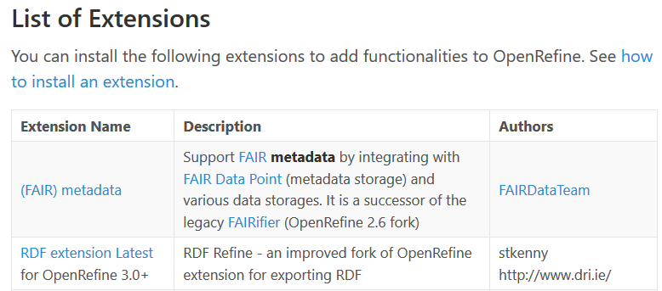

Installing Extensions
-On the RDF extension GitHub page, download the latest release of the extension: OpenRefine 3.3 v1.2.1
-Navigate to the folder on your machine where you have stored your downloaded OpenRefine files
-Navigate to the folder openrefine-3.3/webapp/extensions
-In extensions, reate a new folder titled “rdf-extension”
-Find your downloaded RDF extension zip file. Click to Extract All, and when asked for a destination folder navigate to the new “rdf-extension” folder you created in your OpenRefine extensions. Extract to this location.
-Close the OpenRefine application and re-start it
https://openrefine.org/download.html
Notes:
-Installing extensions is an important first step to taking advantage of some of the online services with which OpenRefine can interact. A list of currently supported extensions is available on the OpenRefine downloads page at: https://openrefine.org/download.html. Let’s try out installation of the RDF extension. RDF stands for “Resource Description Framework,” which is a framework for representing information on the Internet. With this extension in place, we can query APIs and SPARQL endpoints, which is a way of bringing information from outside websites into our OpenRefine projects.

Slide 20
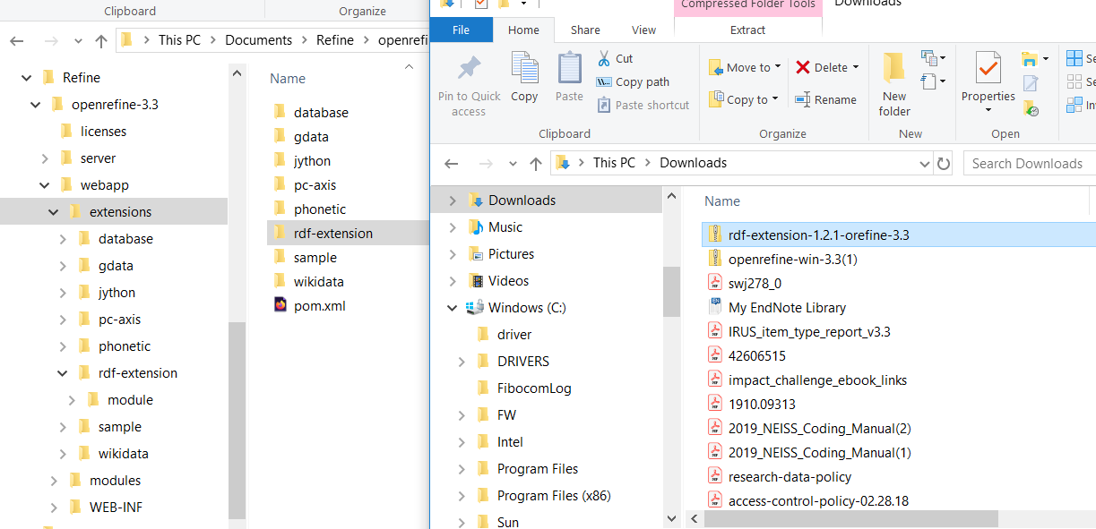


Installing Extensions – Extract to Correct Folder
Extract contents of this folder to the created folder
Create this folder

Slide 21
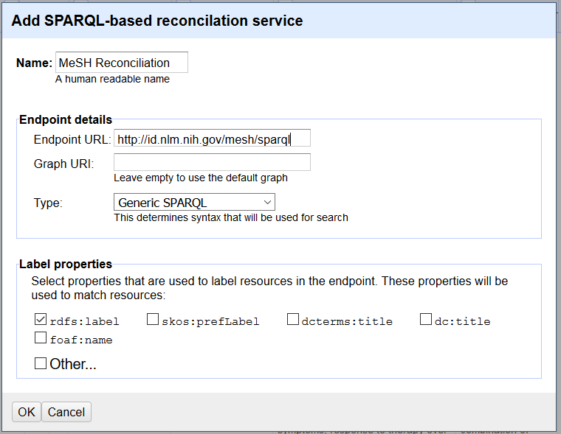
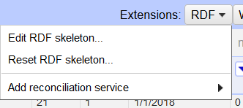
Reconcile using your new Extension
Newly added extension
Enter a human-readable name
Enter the SPARQL endpoint URI
Add a reconciliation service using the RDF extension. This will usually be in the form of a SPARQL endpoint.
SPARQL endpoint for querying MeSH obtained from the NLM’s MeSH RDF technical documentation: https://hhs.github.io/meshrdf/sparql-and-uri-requests
Notes:
From the RDF extension drop down menu at the top right of your OpenRefine project screen, you can find the option to add a reconciliation service. Choose to add a service based on a SPARQL endpoint. A SPARQL endpoint is a kind of port on an HTML website or web service that is capable of receiving queries in a specialized format. When you add such an endpoint to OpenRefine, it allows the program to query the web service.
On the next screen, provide a human-readable name for your SPARQL-based reconciliation service. Then enter the Medical Subject Headings (MeSH) SPARQL endpoint: http://id.nlm.nih.gov/mesh/sparql

Slide 22
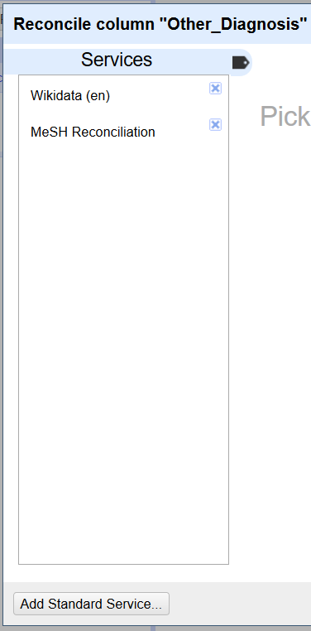
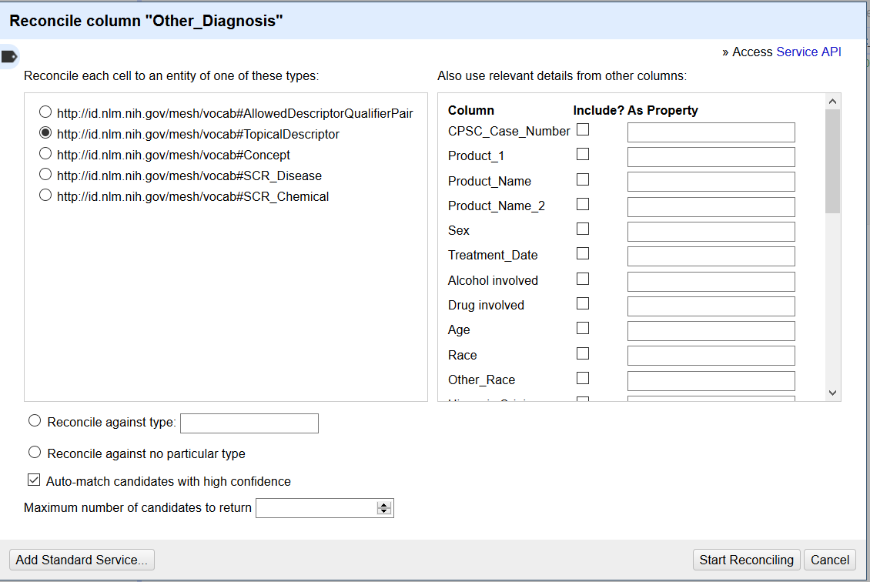
Reconciliation using MeSH SPARQL Endpoint
Notes:
Reconciliation services allow you to look up terms from your data source in other sources online that maintain controlled vocabularies, such as Wikidata or MeSH. This allows you to add to your project metadata values that are expressed in controlled ways, which can help with interoperability. In this example, we will reconcile one value from the Other_Diagnosis column against MeSH in order to find the MeSH-controlled way of expressing it.
To start, Star a row which contains a term in the Other_Diagnosis field that you’d like to reconcile against MeSH. In the example we’ll use the row with ‘hypothermia’ in Other_Diagnosis. Facet by Star from the All column so that only this row is selected. Click the Other_Diagnosis column drop-down and choose: Reconcile → Start reconciling. Choose MeSH Reconciliation, which we installed in the previous step, from the available Services. This will start the query to the MeSH SPARQL endpoint, which can take up to five minutes.
When the Reconciliation screen appears, choose the entity which ends in “TopicalDescriptor” on the left in order to query the MeSH topical subject headings. On the right you can choose other columns from your project that might be helpful to the reconciliation service as it queries MeSH’s available definitions for the chosen term. If none of the other columns are related to your chosen term, leave this area blank. Click “Start Reconciling.” Be prepared to wait a few minutes while OpenRefine queries the Reconciliation service.

Slide 23
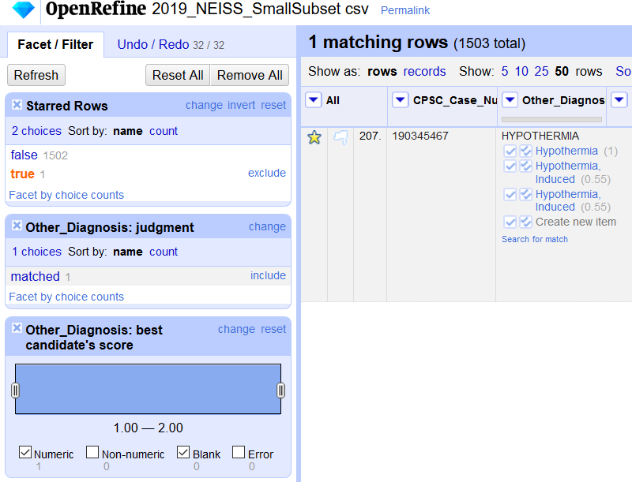
Reconciliation Results
Single check-box: will accept the reconciled value only in this cell
Double check-box: will accept the reconciled value for every identical cell
Notes:
After reconciling, two new facets appear: Other_Diagnosis: judgment and Other_Diagnosis: best candidate’s score. The judgment facet shows which values have been matched. Near “matched,” there may also be a value, “none,” if you ran the Reconciliation over multiple rows and some items failed to match. As you make matches between your values and the reconciled terms, the number in ‘none’ will go down and the ‘matched’ number will go up. The best candidate’s score facet has to do with how well the values matched against those from the online authority file, based on fuzzy matching.
Notice the check-marks next to the choices for matched values back in our original Other_Diagnosis column. As you can see, you can choose to match your original term to the term “Hypothermia” or to two other related terms. To complete the Reconciliation, we can choose one or the other. Clicking the single-check box will accept the answer for one cell. Clicking the multi-check box will accept the new value for all cells in which it appears.
Keep in mind that this function worked quickly in class because we starred and faceted on one row, and therefore were only reconciling one term. The more terms you reconcile at once, the longer it will take for OpenRefine to complete the function. For more on OpenRefine Reconciliation services, see: https://github.com/OpenRefine/OpenRefine/wiki/Reconcilable-Data-Sources

Slide 24
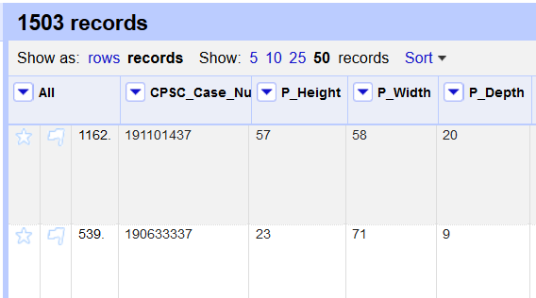
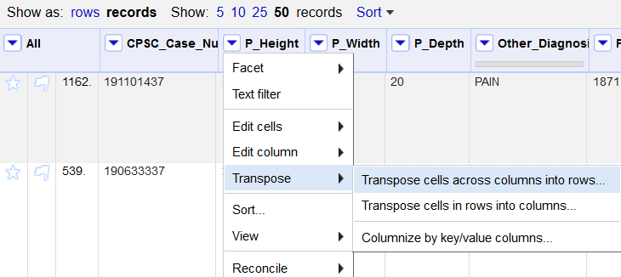
Transposing Columns into Rows
The aim of the data shaping exercise is to take three dimension-based columns, which all have measurements in the same units, and convert them to two columns, Dimension and Measurement.
The more columns that employ measurements in the same units, the more columns can be consolidated to make the dataset more compact.
For tips on Transposing in the opposite direction, rows into columns, see the questions, answers, and examples available on Stack Overflow: https://stackoverflow.com/questions/49677016/transposing-rows-in-openrefine
Notes:
Occasionally in data wrangling a column must be redefined or reconfigured in order to store data in a more logical way. In this exercise we’ll show an example of how to do that by transposing columns. In the project there are three dimension-based columns, P_Height, P_Width, and P_Depth. They could be reconfigured to result in two columns, Dimension and Measurement, with the specific dimension referred to spread out over new rows. Although this may seem confusing, the new rows will remain associated with their original records.
To start, From the All drop down menu go to Edit Columns – Reorder/remove columns and drag P_Height, P_Width, and P_Depth to the top. In the main screen, toggle over to records mode so that OpenRefine understands that we will be applying these changes to entire records, not individual rows.
Make sure that the drag P_Height, P_Width, and P_Depth columns are all next to each other, as this is necessary for Transposition to work. From the drop down arrow at the top of the left-most column (in this case, P_Height), choose Transpose, then Transpose cells across columns into rows.

Slide 25
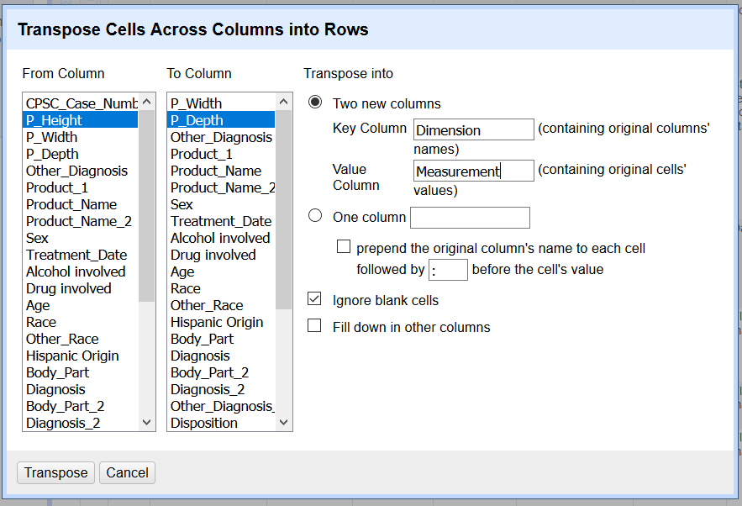
Transposing Columns into Rows, continued
In the Transposition dialog box, choose the beginning and ending columns on the left (From and To)
On the right, name the two new columns Dimension and Measurement
Dimension is a key column, or, the one that contains the original columns’ names
Measurement is a value column, containing the original column’s values
Transposing the original three columns into one columns is also possible, but this results in multi-valued cells which would need to be broken out
Notes:
Ignore blank cells is an option to not have new rows created for P_Height, P_Width, or P_Depth if the measurement value was blank for any instance. If you would like to always see the three new rows in the new, transposed cells, even if the Measurement value is blank, then uncheck Ignore blank cells.
When your Transposition dialog box screen looks like this, click Transpose.

Slide 26
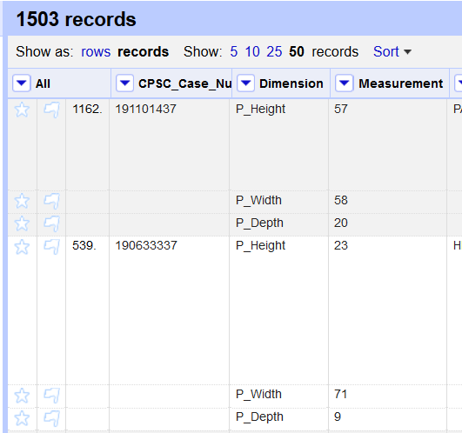
Transposing Columns into Rows, result
The measurement-related columns in the project have now been reduced, from three to two
Although new rows have been added, they are still associated with their original records, as can be seen by the shading cues OpenRefine provides in record mode. The record numbers that OpenRefine assigns are also a cue that no new records have been created
The results can also be viewed in rows mode. However be aware that this will make the dataset appear to expand, as rows are created and all the non-dimensional data is repeated to go with each instance of height, width, and depth. When transposing, it’s best to keep the project in record mode.
Record 1
Record 2

Slide 27
Some final OpenRefine tips
When working with larger datasets, you may want to allocate more memory to OpenRefine. Methods for increasing memory vary by operating system and also according to which version of Java you have.
For a guide on allocating more memory, see: the OpenRefine FAQ: Allocate More Memory
Many additional extensions can be added to OpenRefine to add increased functionality. Installing extensions might involve installing various additional software programs on your computer. Check with NUIT or FSMIT when in doubt.
A list of extensions is available on the OpenRefine downloads page
There is a wealth of additional OpenRefine educational material online! Here is a small sample:
The Google Refine introduction series (pre-dates OpenRefine’s name change, but still useful): https://www.youtube.com/watch?v=B70J_H_zAWM)
A library-focused OpenRefine blog by Owen Stephens
Cleaning Data with OpenRefine by Seth van Hooland, Ruben Verborgh, and Max DeWilde
Getting Started with OpenRefine by Thomas Padilla

Slide 28
Credits
Michael, Brinna. OpenRefine. Joining Projects. University of Illinois Library LibGuides, https://guides.library.illinois.edu/openrefine/joiningprojects. Accessed 2020-07-23.
National Institutes of Health. US National Library of Medicine. MeSH RDF Technical Documentation. https://hhs.github.io/meshrdf/sparql-and-uri-requests. Accessed 2020-08-27.
United States Consumer Product Safety Commission. National Electronic Injury Surveillance System (NEISS). NEISS Estimates Query Builder. https://www.cpsc.gov/cgibin/NEISSQuery/home.aspx. Accessed 2020-06-01.
Verborgh, Ruben, and Max De Wilde. Using OpenRefine. Packt Publishing Ltd, 2013.
Slides and NEISS dataset segment used for this class can be found at: https://github.com/saragon02/Class_materials
Cover slide image by kues1, accessed at: https://www.freepik.com/free-photo/old-files_1012333.htm
Developed resources reported in this presentation are supported by the National Library of Medicine (NLM), National Institutes of Health (NIH) under cooperative agreement number 1UG4LM012346. The content is solely the responsibility of the authors and does not necessarily represent the official views of the National Institutes of Health.

